Slide 1
Unit 2
8085 Pin Diagram

Slide 2
Microprocessor
The term micro initiates its physical size; not it’s computing power
The main sections of a microprocessor are: ALU, timing and control unit, accumulator, general purpose and special purpose registers

Slide 3
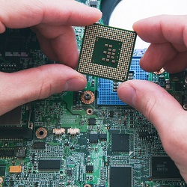
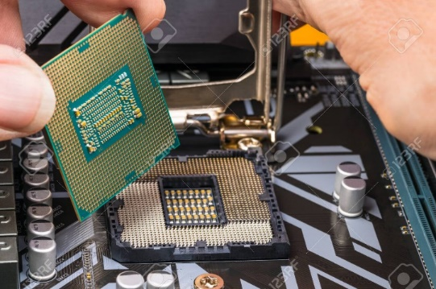
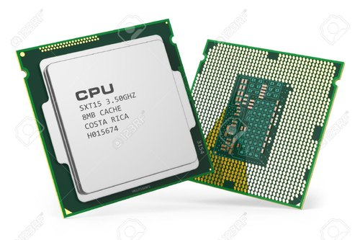
Microprocessor
A microprocessor is an electronic component that is used by a computer to do its work.
It is a central processing unit on a single integrated circuit chip containing millions of very small components including transistors, resistors, and diodes that work together.
The microprocessor is the central unit of a computer system that performs arithmetic and logic operations, which generally include adding, subtracting, transferring numbers from one area to another, and comparing two numbers.
It's often known simply as a processor, a central processing unit, or as a logic chip.

Slide 4
Main task of Processor :
Fetch
Decode
Execute

Slide 5
Basic Functions of processor
Programmer write a program using HLL or ALP(instructions)
Assmbler will convert HLL/ALP into machine code.(opcode of instructions (hex))
Loader is responsible to load program into memory (binary form)
Memory
0000
0001
* Individual location size of memory is always 1Byte i.e. 8 bits.
* Entire memory size of memory is depend upon the address bus size of processor.
Processor
0002
Address bus / Data bus
FFFF
Processor calculates the memory address and fetch the content of that memory location.
Processor decodes the fetched instruction and execute it.
Content of memory location can be Data/instructions

Slide 6
8085 Microprocessor
Intel 8085 is an 8-bit, N-channel Metal Oxide semiconductor (NMOS) microprocessor
It is a 40 pin IC package fabricated on a single Large Scale Integration (LSI) chip
It has 8 data lines and 16 address lines hence capacity = 64 kB of memory

Slide 7
The Intel 8085 uses a single +5V DC supply for its operation
Its clock speed is about 3MHz
74 instructions with five addressing modes.
5 hardware interrupt and 8 software interrupts

Slide 8
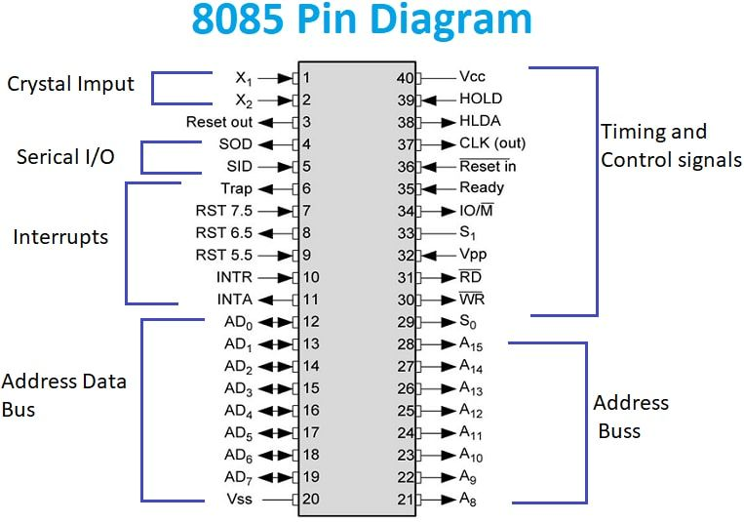

Slide 9
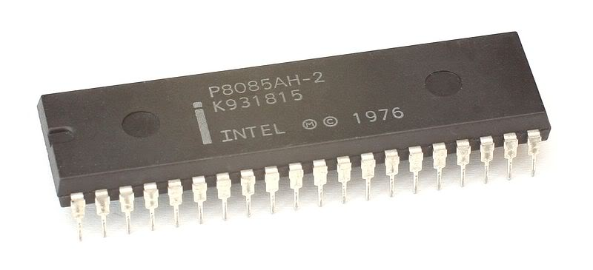
8085 Pins
The pin groups:
Address Bus and Data Bus.
Control and Status Signals.
Power supply and frequency.
Externally Initiated Signals.
Serial I/O ports.

Slide 10
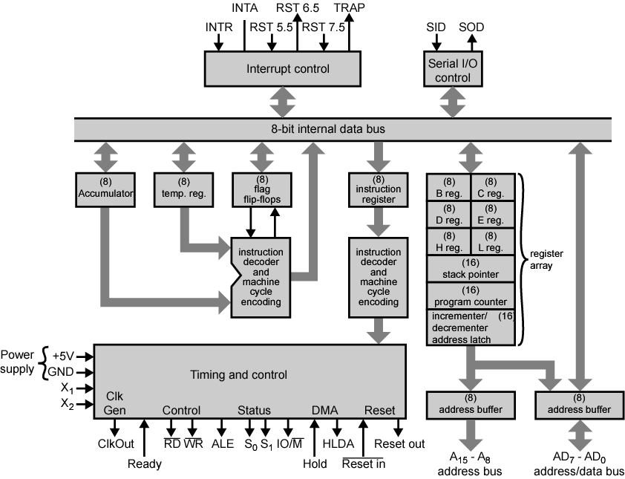
8085 Microprocessor Architecture
8085 Microprocessor Architecture

Slide 11
8085 Architecure
Architectural Blocks:
Register
IR,Decoding Unit and Timing Control Unit
Interrupts
Serial I/O

Slide 12
Arithmetic Logical Unit
The ALU performs the following arithmetic and logical operations.
Addition
Subtraction
Logical AND
Logical OR
Logical EXCLUSIVE OR
Complement (logical NOT)
Increment (add 1)
Decrement (subtract 1)
Left shift
Clear

Slide 13
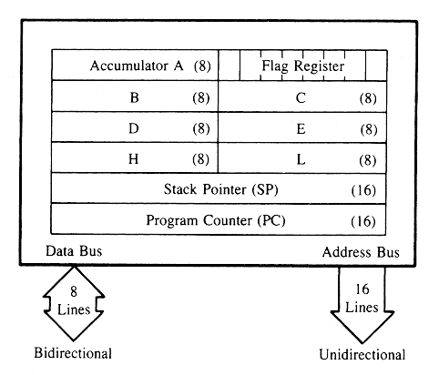
Register Set

Slide 14
General Registers
The 8085 has six general-purpose registers to store 8-bit data; these are identified as B, C, D, E, H, and L
They can be combined as register pairs - BC, DE, and HL - to perform some 16-bit operations
The programmer can use these registers to store or copy data into the registers by using data copy instructions
HL register pair plays the role of memory address register

Slide 15
Accumulator & Pointers
The accumulator is an 8-bit register that is a part of arithmetic/logic unit (ALU)
Program Counter - Deals with sequencing the execution of instructions. Acts as a memory pointer
PC is a 16-bit register.
It contains a memory address. PC contains that Every memory address from where the next instruction is to be fetched for execution.
Suppose the PC contents are 8000H, then it means that the 8085 Desires to fetch the instruction Byte at 8000H.
After fetching the Byte at 8000H, the PC is automatically incremented by 1. This way 8085 becomes ready to fetch the next Byte of the instruction (in case instruction fetch is incomplete), or fetch the next opcode (in case instruction fetch is over).
Stack Pointer – Points to a memory location in R/W memory, called the stack

Slide 16
Instruction Register/Decoder
The instruction register and the decoder are considered as a part of the ALU
The instruction register is a temporary storage for the current instruction of a program
The decoder decodes the instruction and establishes the sequence of events to follow

Slide 17
Timing & Control Unit
This unit works as the brain of the CPU and generates all the timing and control signals to perform all the internal & external operations of the CPU.

Slide 18
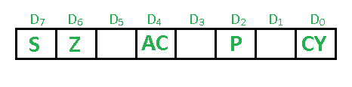
Flags
The Flag register is a Special Purpose Register. Depending upon the value of result after any arithmetic and logical operation the flag bits become set (1) or reset (0). In 8085 microprocessor, flag register consists of 8 bits and only 5 of them are useful.
Sign Flag (S)
Zero Flag (Z)
Auxiliary Cary Flag (AC)
Parity Flag (P)
Carry Flag (CY)

Slide 19
Sign Flag (S) – After any operation if the MSB (B(7)) of the result is 1, it indicates the number is negative and the sign flag becomes set, i.e. 1. If the MSB is 0, it indicates the number is positive and the sign flag becomes reset i.e. 0. from 00H to 7F, sign flag is 0 from 80H to FF, sign flag is 1
MSB is 1 (negative) MSB is 0 (positive)
Example:
MVI A 30 (load 30H in register A) MVI B 40 (load 40H in register B) SUB B (A = A – B) These set of instructions will set the sign flag to 1 as 30 – 40 is a negative number.
MVI A 40 (load 40H in register A) MVI B 30 (load 30H in register B) SUB B (A = A – B) These set of instructions will reset the sign flag to 0 as 40 – 30 is a positive number.

Slide 20
Zero Flag (Z) –
After any arithmetical or logical operation if the result is 0 (00)H, the zero flag becomes set i.e. 1, otherwise it becomes reset i.e. 0. zero flag 1-zero result
Zero flag 0- non-zero result
Example:
MVI A 10 (load 10H in register A) SUB A (A = A – A) These set of instructions will set the zero flag to 1 as 10H – 10H is 00H
Parity Flag (P) – If after any arithmetic or logical operation the result has even parity, an even number of 1 bits, the parity register becomes set i.e. 1, otherwise it becomes reset i.e.
accumulator has even number of 1 bits parity flag=1 accumulator has odd number of 1 bits parity flag=0
Example:
MVI A 05 (load 05H in register A) This instruction will set the parity flag to 1 as the Binary Code of 05H is 00000101, which contains even number of ones i.e. 2.

Slide 21
Auxiliary Carry Flag (AC) – This flag is used in BCD number system(0-9). If after any arithmetic or logical operation D(3) generates any carry and passes on to B(4) this flag becomes set i.e. 1, otherwise it becomes reset i.e. 0. This is the only flag register which is not accessible by the programmer
1-carry out from bit 3 on addition or borrow into bit 3 on subtraction 0-otherwise
Example:
MOV A 2B (load 2BH in register A) MOV B 39 (load 39H in register B) ADD B (A = A + B) These set of instructions will set the auxiliary carry flag to 1, as on adding 2B and 39, addition of lower order nibbles B and 9 will generate a carry.

Slide 22
Carry Flag (CY) – Carry is generated when performing n bit operations and the result is more than n bits, then this flag becomes set i.e. 1, otherwise it becomes reset i.e. 0. During subtraction (A-B), if A>B it becomes reset and if (A<B) it becomes set.
Carry flag is also called borrow flag.
1-carry out from MSB bit on addition or borrow into MSB bit on subtraction 0-no carry out or borrow into MSB bit
Example:
MVI A 30 (load 30H in register A) MVI B 40 (load 40H in register B) SUB B (A = A – B) These set of instructions will set the carry flag to 1 as 30 – 40 generates a carry/borrow.
MVI A 40 (load 40H in register A) MVI B 30 (load 30H in register B) SUB B (A = A – B) These set of instructions will reset the sign flag to 0 as 40 – 30 does not generate any carry/borrow.

